Slide 1
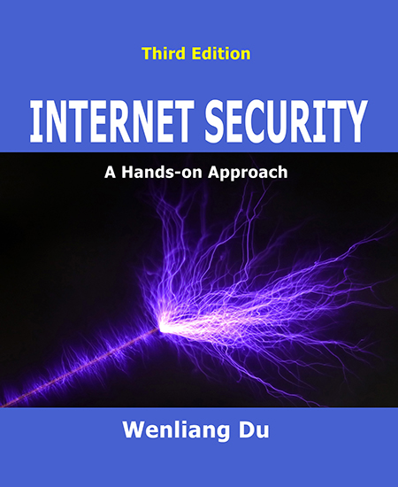
NT101-Network Security
Week 08-09: Network layer security
Ngoc-Tu Nguyen, PhD
tunn@uit.edu.vn

Slide 2
Outline
ARP poisoning and MiMA attacks (review)
The Role of the IP layer
IP Header
IP Fragmentation and Attacks
Routing
ICMP and Attacks

Slide 3











Motivations
source
application
message
M
Secure Routing
Seccure hop-by-hop
segment
H_{t}
M
transport network
H_{t}
datagram
H_{n} H_{t}
M
H_{n}
Intermediary devices
frame
H_{l}
H_{n} H_{t} M
link physical
next hop?
H_{l} | H_{n} | H_{t} | M
link physical
switch
next hop?
MAC?
destination
H_{n} | H_{t} | M
network
IP router
M
application
transport
network
link
physical
H_{l} | H_{n} | H_{t} | M
link physical
H_{n}
H_{t}
M
next hop?
H_{t}
M
Routing!
 | H_{n} | H_{t} | M
H_{l} | H_{n} | H_{t} | M

Slide 4
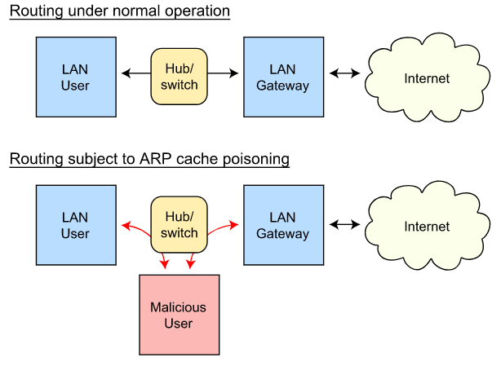
ARP Cache Poisoning
MAC Layer attack
IP U:MAC U
IP H:MAC H
IP G:MAC G
ARP cache table!
How to cause ARP to update its cache?
➔ Sending out
ARP Request
ARP Reply
ARP Gratituous (broadcast response)
ARP table:
IP H:MAC M
ARP table:
IP H:MAC M
M

Slide 5



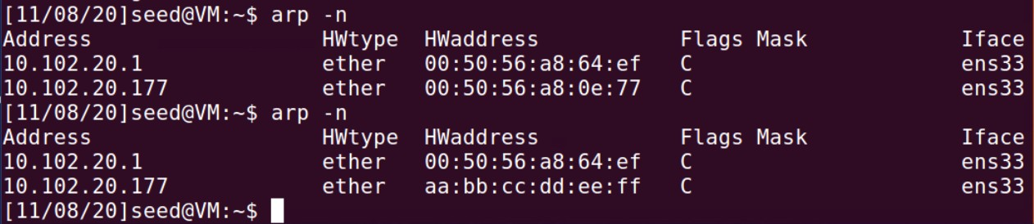
ARP Poisoning Attack code example
LAN
A
B
Target: 10.102.20.178
MAC: 00:50:56:a8:1a:d3
Victim IP: 10.102.20.177
MAC: 00:50:56:a8:0e:77
ARP cache table
M
IP: 10.102.20.177 MAC: 00:50:56:a8:0e:77
Attacker
IP: 10.102.20.154
IP: 10.102.20.177 MAC: aa:bb:cc:dd:ee:ff
MAC: aa:bb:cc:dd:ee:ff
Before
After

Slide 6
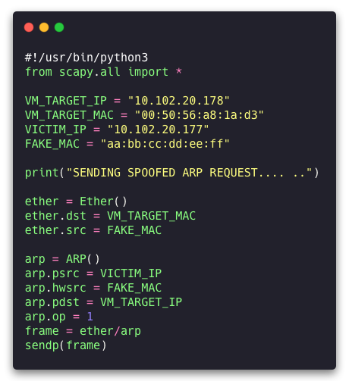
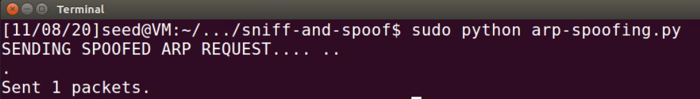
ARP Poisoning Attack code example
Spoofing ARP Request
Attacker IP: 10.102.20.154
Target: 10.102.20.178 – MAC: 00:50:56:a8:1a:d3 Victim IP: 10.102.20.177 – MAC: 00:50:56:a8:0e:77
Sending spoofed ARP request directly to Victim (Unicast)
When A receives this, it is going to see that 10.102.20.177 is mapped to this fake MAC
➔ add to ARP cache.
Before
After

Slide 7
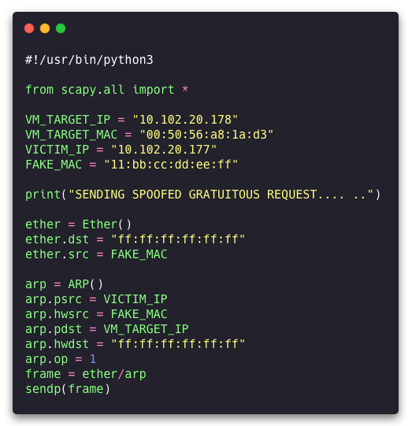
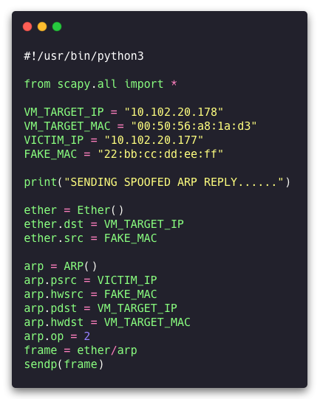
ARP Poisoning Attack code example
Spoofing ARP Gratuitous and Reply
ARP Gratuitous
ARP Reply

Slide 8



Remind: Man-in-the-middle attack
Diffie-Hellman key exchange
Share a prime number p and g < p (g is a primmitive root of p)
a
A ← gª mod p
b
g^{b} mod p → B
A
B
M
M
K_{A} ←Mª mod p = g^{ma} mod p
Micheal
m
K ←M^{b} mod p = g^{mb} mod p
B
Bob
Alice
M ← g^{m} mod p
K₁ = A^{m} mod p = g^{am} mod p = K_{A}
K₂ = B^{m} mod p = g^{bm} mod p = K_{B}
E(K_{A}, M)
D(K_{A}, M)
E(K_{B}, M)
D(K_{B}, M)
I love you
» M m
: + (
I love you
I hate you
x * #
@ $ (
I hate you

Slide 9
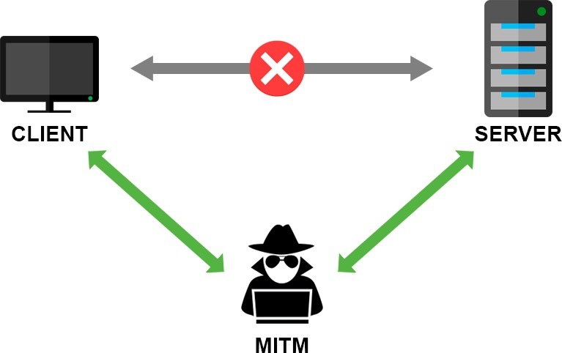

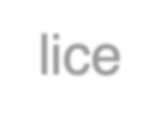






Main-in-the-Middle (MITM) Attack
Using ARP cache poisoning
Attack idea:
M has to be on the same network as A and B
➔ try to cache poison A and B’s cache
Alice
Bob
ARP table
IP: IP B
MAC: MAC B
→ MAC M
ARP table
IP: IP A
MAC: MAC A
→ MAC M
When A is sending a packet to B
IP header is still: IP A → IP B
MAC address: MAC A → MAC M
→ B can still get A’s packet but will drop it!
MAC M
MAC M
Micheal
(can see or modify)
What’s going to happen when that frame arrives at M?

Slide 10





Main-in-the-Middle (MITM) Attack (cont.)
Using ARP cache poisoning
When that frame arrives at M:
dstIP = IP B
DHCP
UDP
IP
Eth
Phy
Alice
Bob
M
ARP table
IP: IP B
MAC: MAC B
→ MAC M
ARP table
IP: IP A
MAC: MAC A
→ MAC M
➔ 2 scenarios:
MAC M
MAC M
If M is configured as a router
→ Relay that packet to B
If M is configured as a hosts
→ Drop the packet
Micheal
(can see or modify)
So, what we need to do next?

Slide 11
Main-in-the-Middle (MITM) Attack
Using ARP cache poisoning
Then, make some changes and send it out!
Alice
Bob
ARP table
IP: IP B
MAC: MAC B
→ MAC M
ARP table
IP: IP A
MAC: MAC A
→ MAC M
MAC M
MAC M
➔ B gets the modified packet!
Micheal
(can see or modify)
IP Forwarding = 0

Slide 12




source
Packet’s Traversal
message
M
application transport network
segment
H_{t}
M
H_{t}
datagram
H_{n} H_{t}
M
H_{n}
frame
H_{l}
H_{n} H_{t} M
link physical
Which ouput link?
link physical
switch
ARP table
destination
H_{n} | H_{t} | M
network
Which ouput link?
M
application
transport
network
link
physical
H_{l} | H_{n} | H_{t} | M
link physical
H_{n}
H_{t}
M
H_{t}
M
 | H_{n} | H_{t} | M
H_{l} | H_{n} | H_{t} | M
router

Slide 13


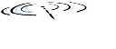













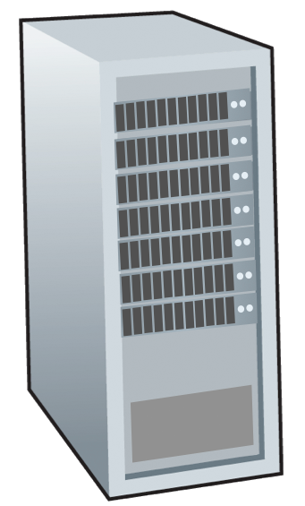



























Network-layer services and protocols
transport segment from sending to receiving host
sender: encapsulates segments into datagrams, passes to link layer
receiver: delivers segments to transport layer protocol
network layer protocols in every Internet device: hosts, routers
routers:
examines header fields in all IP datagrams passing through it
moves datagrams from input ports to output ports to transfer datagrams along end-end path
mobile network
na
P
application
transport
network
link
physical
network
network
link
link
physical
physical
network
network
link physical
link physical
network
er
link
physical
application
transport
enterprise
network
network
link
physical

Slide 14
Packet Forwarding and Routing
203.105.8.11
A
B
129.10.5.5
129.10.1.1
129.9.124.1
A send a package to C?
C
Need IP header!
129.10.1.25

Slide 15

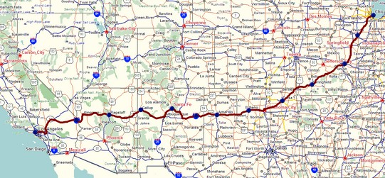
Two key network-layer functions
network-layer functions:
forwarding: move packets from a router’s input link to appropriate router output link
routing: determine route taken by packets from source to destination
routing algorithms
analogy: taking a trip
forwarding: process of getting through single interchange
routing: process of planning trip from source to destination
forwarding
routing

Slide 16







Network layer: data plane, control plane
Data plane:
local, per-router function
determines how datagram arriving on router input port is forwarded to router output port
values in arriving packet header
Control plane
network-wide logic
determines how datagram is routed among routers along end- end path from source host to destination host
two control-plane approaches:
traditional routing algorithms:
implemented in routers
software-defined networking (SDN):
implemented in (remote) servers
0111

Slide 17





































































Per-router control plane
Individual routing algorithm components in each and every router interact in the control plane
Routing Algorithm
control plane
Local forwarding table
data plane
header | output
0100 | 3
0110 | 2
0111 | 2
1001 | 1
values in arriving packet header
0111
1
3
2

Slide 18






























































Software-Defined Networking (SDN) control plane
Remote controller computes, installs forwarding tables in routers
Remote Controller
control plane
data plane
CA
CA
CA
CA
CA
values in arriving packet header
0111
1
3
2

Slide 19
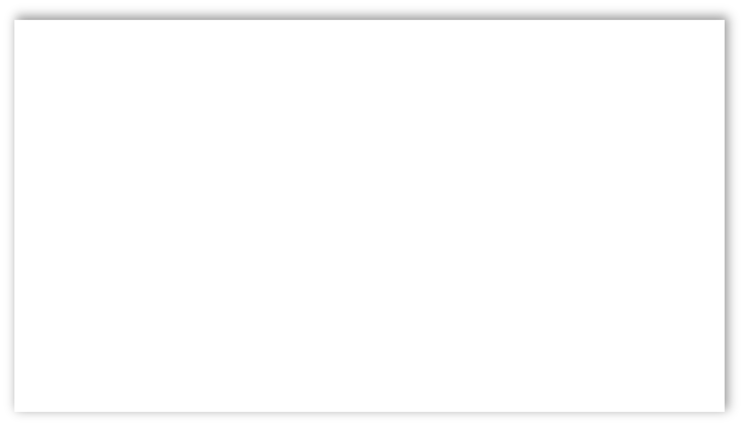

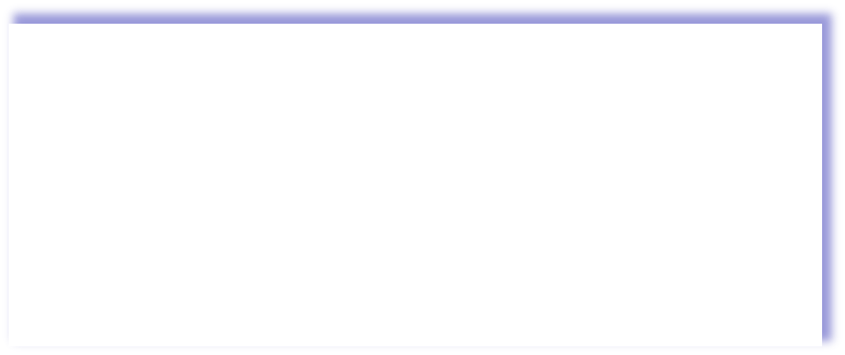

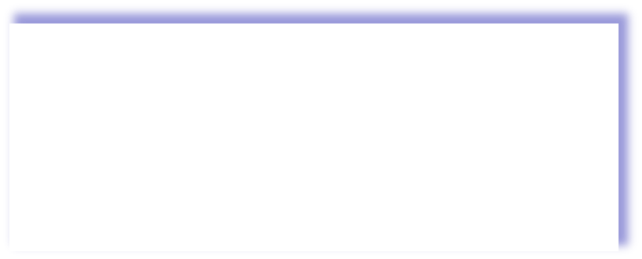
Network Layer: Internet
host, router network layer functions:
transport layer: TCP, UDP
Path-selection ^{IP protocol} _{algorithms:} • datagram format addressing implemented in • packet handling conventions routing protocols ^{forwarding} (OSPF, BGP) table ICMP protocol SDN controller • error reporting router “signaling”
link layer
physical layer
network
layer

Slide 20

IP Datagram format
IP header
32 bits
IP protocol version number (4 bits)
header length(bytes) (4 bits)
total datagram
ver
head. type of len service
length (bytes) (16 bits)
fragmentation/ reassembly
header checksum
32-bit source IP address
length
“type” of service:
diffserv (0:5)
flgs
fragment offset
16-bit identifier
time to live
upper layer
header
ECN (6:7)
checksum
TTL: remaining max hops
(decremented at each router)
source IP address
Maximum length: 64K bytes
destination IP address
it destination IP address
timestamp, record
upper layer protocol (e.g., TCP or UDP)
^{32-b} Typically: 1500 bytes or less
options (if any)
_{e.g.,} Can we overflow this value?
overhead
payload data (variable length, typically a TCP or UDP segment)
route taken
20 bytes of TCP
20 bytes of IP
▪ = 40 bytes + app layer overhead for TCP+IP

Slide 21
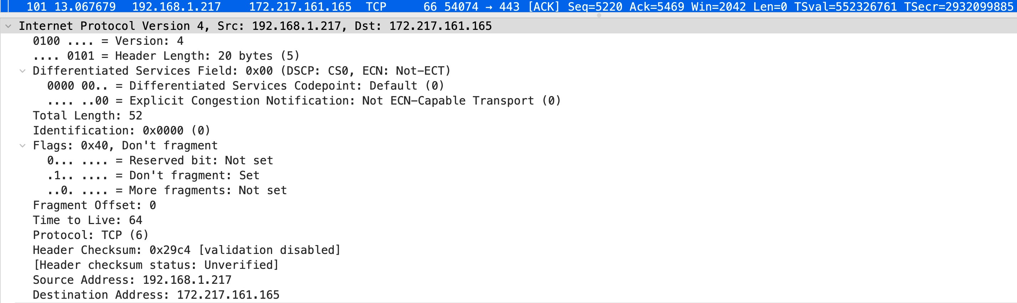
IP header
An example
21

Slide 22







Time-to-Live and How Traceroute works
ICMP Protocol
3 probes
3 probes
3 probes
source sends sets of UDP segments to destination
stopping criteria:
₁st
UDP segment eventually arrives at destination host
destination returns ICMP “port unreachable” message (type 3, code 3)
source stops
set has TTL =1, 2nd set has TTL=2, etc.
datagram in n^{th} set arrives to n^{th} router:
router discards datagram and sends source ICMP message (type 11, code 0)
ICMP message possibly includes name of router & IP address
when ICMP message arrives at source: record RTTs

Slide 23
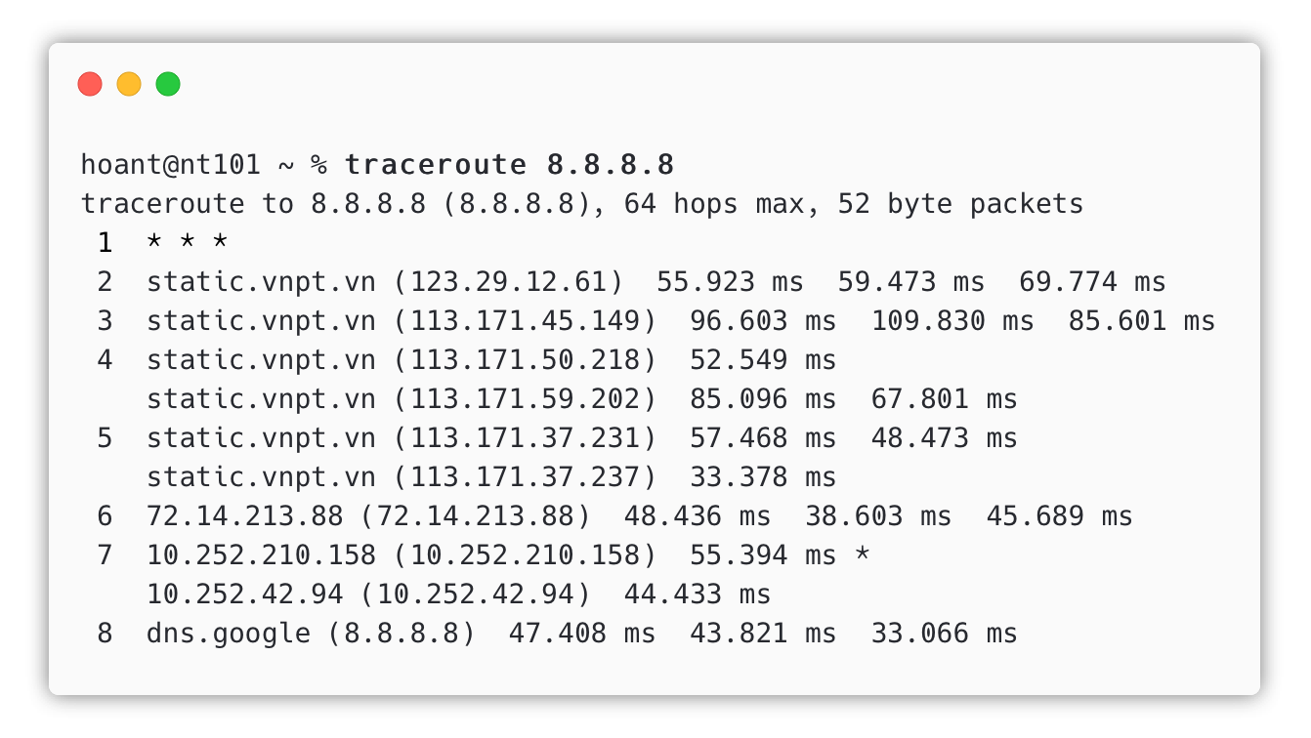
Traceroute example
ICMP Protocol
<< What happened here?
Why we need to set TTL?

Slide 24

IP Fragmentation
Attack
NT101 – Network Security

Slide 25









IP fragmentation/reassembly
The need for Fragmentation
network links have MTU (max. transfer size) - largest possible link-level frame
different link types, different MTUs
large IP datagram divided (“fragmented”) within net
fragmentation:
in: one large datagram
out: 3 smaller datagrams
…
one datagram becomes several datagrams
“reassembled” only at destination
IP header bits used to identify, order related fragments
reassembly
…
hoant@uit.edu.vn
25

Slide 26
IP fragmentation/reassembly
max. transfer size
message
M
application transport network
len(Ht)=20 bytes
MTU
fragmentation:
in: one large datagram
out: 3 smaller datagrams
segment
H_{t}
M
len(Hn) = 20 bytes
H_{t}
…
datagram
H_{n} H_{t}
M
H_{n}
frame
H_{l}
H_{n} H_{t} M
link physical
len(message)=MTU-40 bytes
reassembly
…
hoant@uit.edu.vn
26

Slide 27
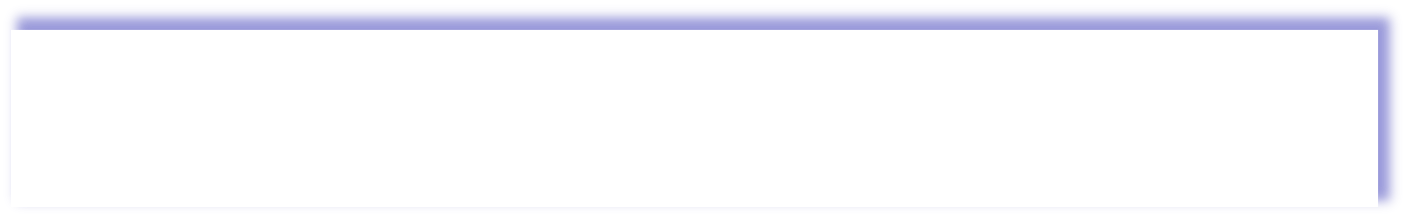
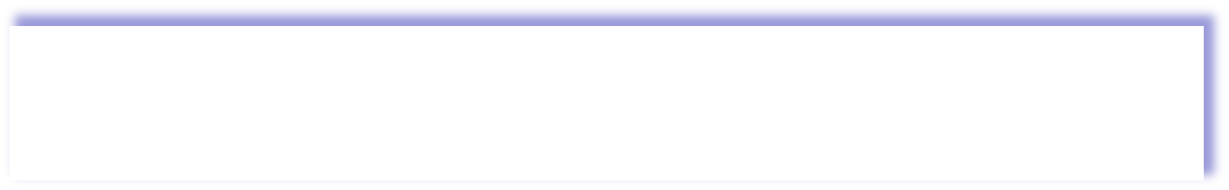
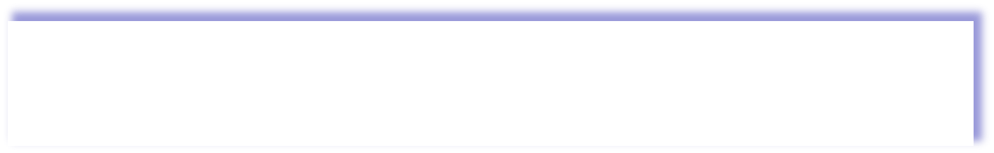
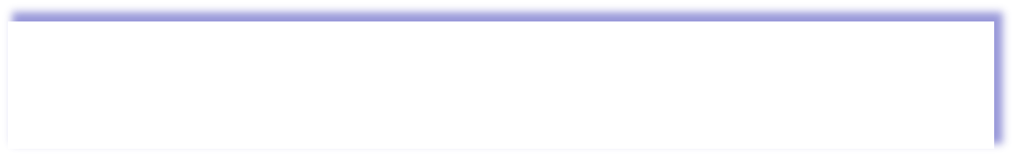
IP fragmentation/reassembly
Example
4000-byte datagram
MTU = 1500 bytes (1480 bytes + 20bytes Hn)
20 bytes Ht
20 bytes Hn
▪ = 40 bytes + app layer overhead for TCP+IP
 | length =4000 | ID =x | fragflag =0 | offset =0
one large datagram becomes several smaller datagrams
1480 bytes in data field (0-1479)
offset 1480/8
Why offset need to be devided by 8?
4000 -20=
1480 | 1480 | 1020
Length = 16 bits, ID = 3 bits, Flag = 3 bits, Fragment offset = 13 bits
 |  |  | length =1500 | ID =x | fragflag =1 | offset =0
1480 + 20
(0-1479)
1480 + 20
(1480-2959)
= |  | length | ID | fragflag | offset
 |  | =1500 | =x | =1 | =185
 | length =1040 | ID =x | fragflag =0 | offset =370
1020 + 20
(2960-3900)
Offset= the first byte of the fragment
fragflag=0: terminal fragment
fragflag=1: other fragments follow
https://datatracker.ietf.org/doc/html/rfc791

Slide 28
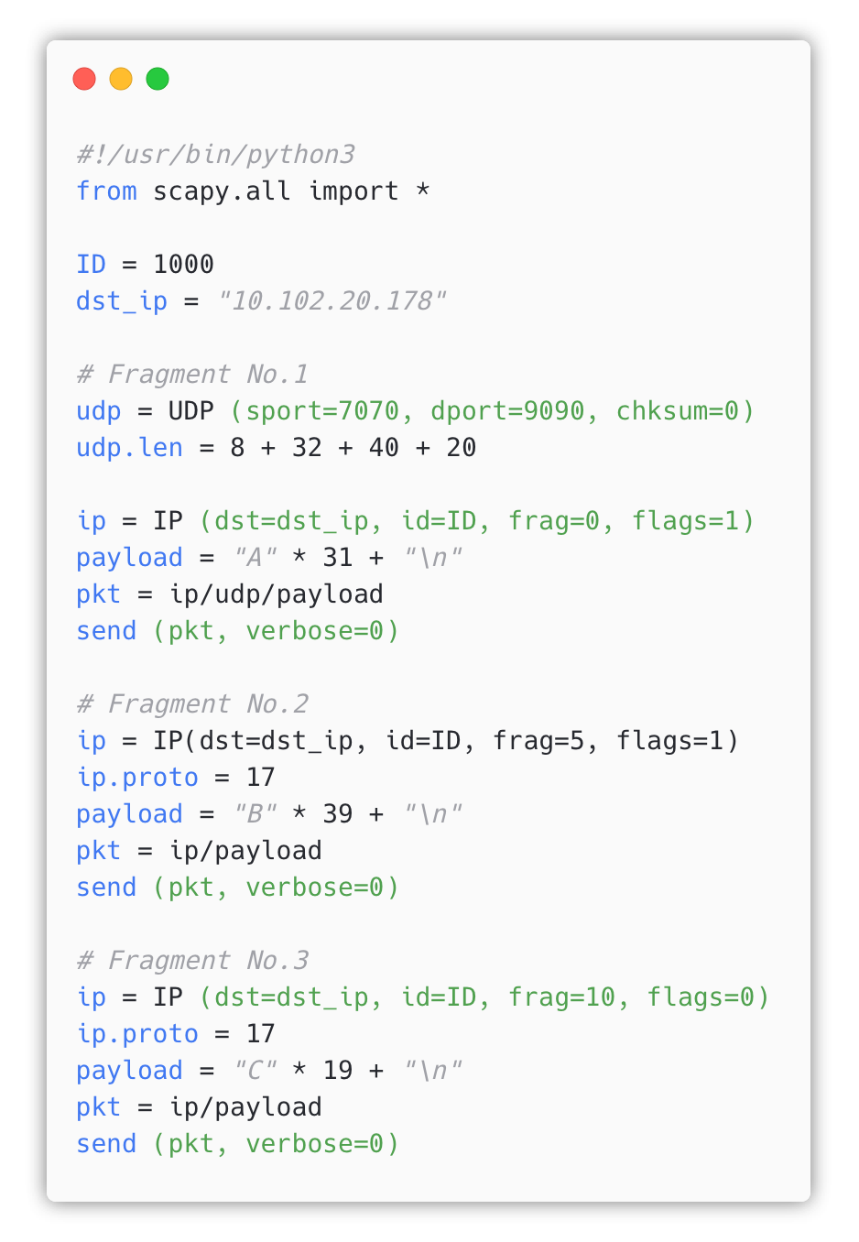
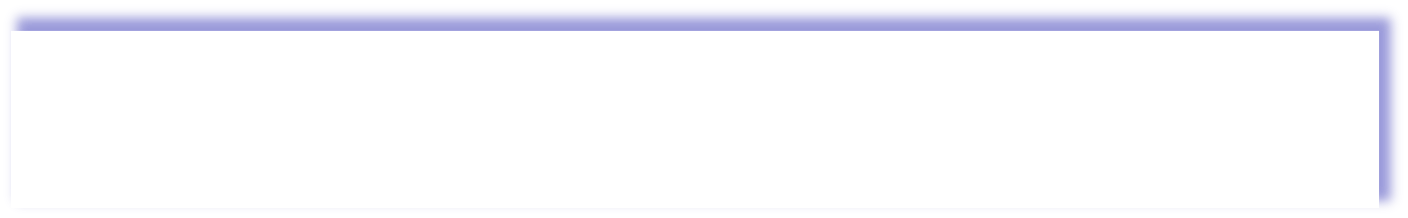
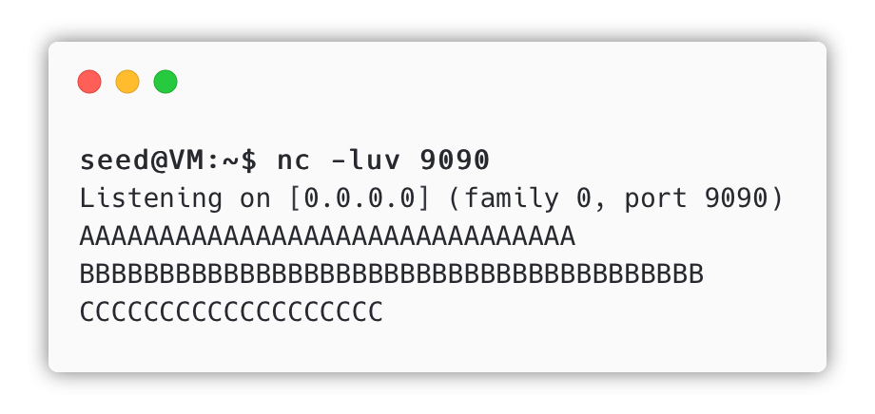
Construct IP Fragments Manually
Using Scapy
 | length = x | ID =y | fragflag =n | offset =n
frag = offset value
flags = fragment flag
ip.proto = 17: UDP
Execution Result
28

Slide 29
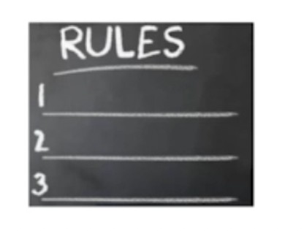

Attacks Using IP Fragmentation
Protocol Violation
Protocols Are Rules
→ Attackers Like to Break Rules
➔ Robust Programs Handle Rule Violations

Slide 30
Can you break the rules?
Attacks Using IP Fragmentation
Q1: Can you create an IP packet that is larger than 65,536 bytes (64KB)?
Super large package attacks!
Q2: Can you create some abnormal conditions using "offset" and "payload size"?
Create abnormal situations attacks!
Goal: Test whether a computer can handle these "unreal" conditions.
Q3: Can you use a small amount of bandwidth to tie up a target machine's significant amount of resources?
Tie Up Target's Resource attacks!

Slide 31

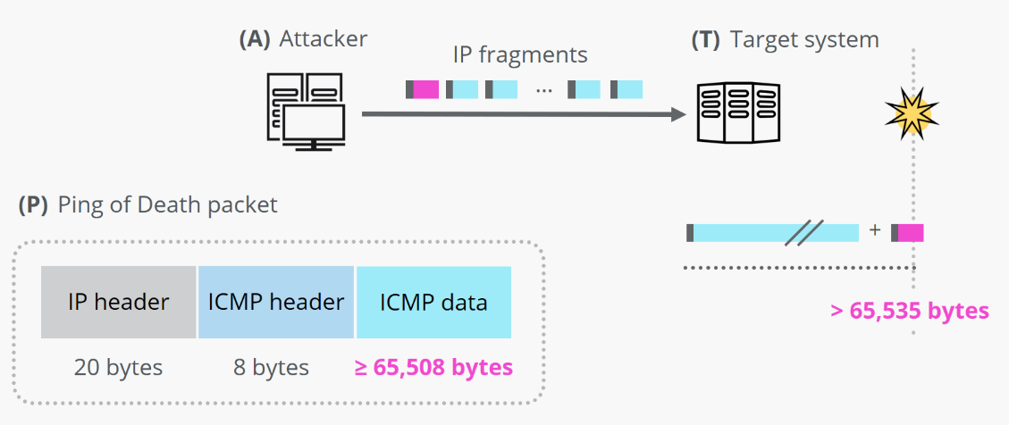

Ping of Death (PoD) attack
Attack 1: Create a Super-Large Packet
Q1: Can you create an IP packet that is larger than 65,536 bytes? → Violate the IP protocol → buffer overflow
➔ The Ping-of-Death Attack
https://en.wikipedia.org/wiki/Ping_of_death
ping packet = 64KBs ICMP = 65,536 bytes
ICMP data = 65536-20 -8= 65508
https://www.ionos.com/digitalguide/server/security/ping-of-death/

Slide 32
Ping of Death (PoD) attack
Attack 1: Create a Super-Large Packet
Q1: Can you create an IP packet that is larger than 65,536 bytes? → Violate the IP protocol → buffer overflow
➔ The Ping-of-Death Attack
ping packet = 64KBs ICMP = 65,536 bytes
ICMP data = 65536-20 -8= 65508
https://www.ionos.com/digitalguide/server/security/ping-of-death/

Slide 33
Ping of Death (PoD) attack
Attack 1: Create a Super-Large Packet
Last fragment:
offset = ??
For example:
MTU=1500:
Number of fragments: ceiling(65508/1472)=45
20 | 8 | 1472
20 | 8 | 1000
First 44 fragments: 44 x 1472 = 64768
Reassembled:64768 +1000=65 768 > 65 508
Dead!

Slide 34

A Recent Ping of Death Vulnerability
1997’s vuln. is coming back!
A remote code execution vulnerability exists when the Windows TCP/IP stack improperly handles ICMPv6 Router Advertisement packets, aka 'Windows TCP/IP Remote Code Execution Vulnerability'.
How to mitigate PoD?
https://msrc.microsoft.com/update-guide/en-US/vulnerability/CVE-2020-16898

Slide 35
CVE-2020-16898
[Windows TCP/IP Remote Code Execution vulnerability]
exploit proof-of-concept
October 13, 2020

Slide 36

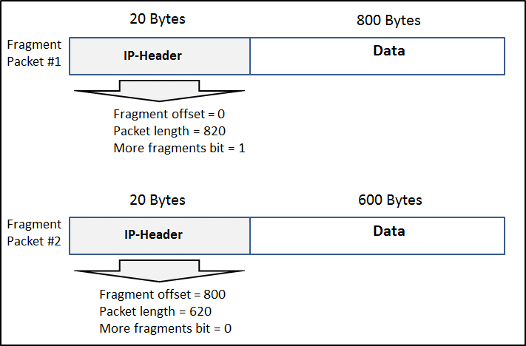










Teardrop Attacks
Attack 2: Create Abnormal Situations
unable to reassemble the packet, causing overload!
Q2: Can you create some abnormal conditions using "offset" and "payload size"?
Goal: Test whether a computer (A) can handle these "unreal" conditions.
→ A cannot reassemble fragmented data packets
→ the packets overlap one another, crashing the target network device.
820!
H1 T1
H1
length = 820
T1
length = 820
offset = 0
offset = 0
H2
offset = 600
T2
H2
T2
length = 420
length = 820
offset =200
620!
T2 – T1
→ OK
T2 – T1 !!!
→ negative → HUGE

Slide 37
Denial of Service Attack
Attack 3: Tie Up Target's Resources
Q3: Can you use a small amount of bandwidth to tie up a target machine's significant amount of resources?
→ Send out 2 tiny packet ~ 100 bytes ➔ tie up significant amount of resources on the server ~ 64KB
→ Very efficient approach for DoS attack!
offset = 0
buffer = 64 KB
Packet 1
Approach 1
(static buffer)
Packet 2
offset ~ 65535
Approach 2
(linked list)
More complicated, time to implement!

Slide 38
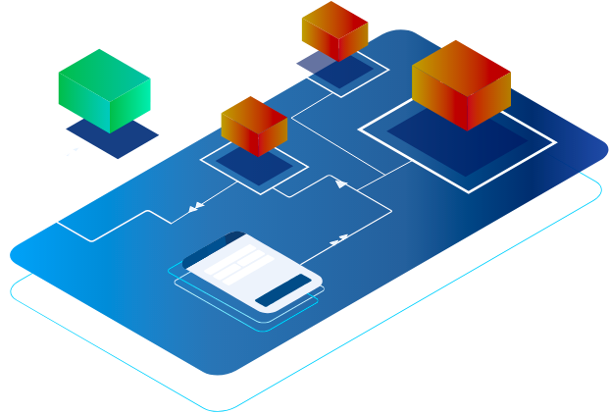
Routing
and how to mitigate attacks
NT101 – Network Security

Slide 39
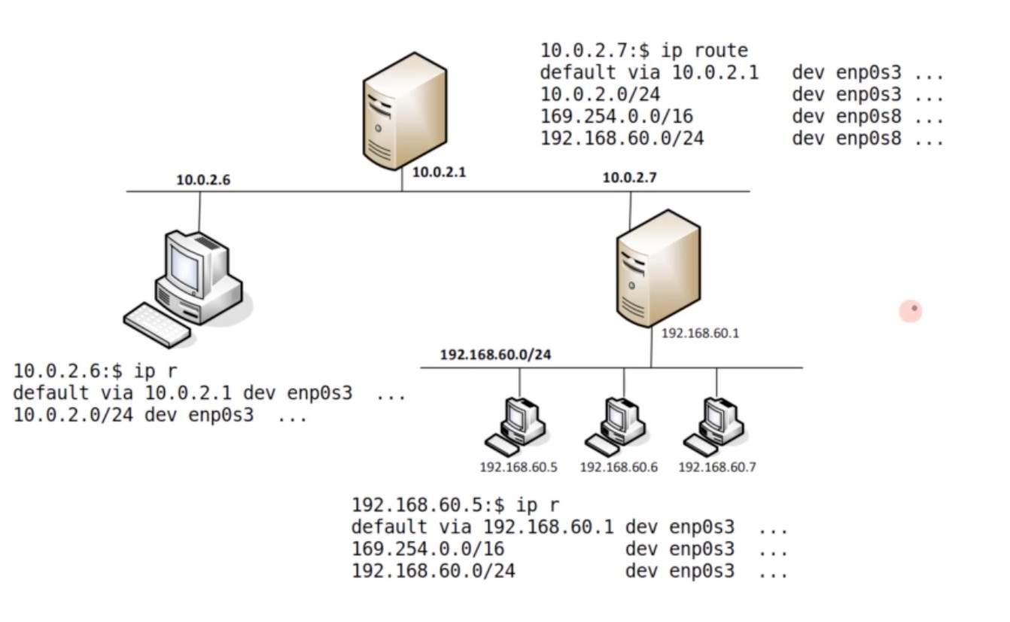
Routing Scenario
Network Topology
Internet
enp0s3
enp0s3
A
enp0s8
B
A wanna talk to B
→ Will it work?

Slide 40
Change routing table
Linux routing
Add an IP Route entry $ sudo ip route add | 192.168.60.0/24 | dev | enp0s3 | via | 10.0.2.7
Delete an IP Route entry $ sudo ip route del | 192.168.60.0/24
Show IP Route table $ ip route (route)

Slide 41
Routing Rules
Routing priority
Question: What interface will be used to route packets to (1) 192.200.60.5?
(2) 192.168.30.5?
(3) 192.168.60.5?
default-route
A: 0.0.0.0/0
B: 192.168.0.0/16 C: 192.168.60.0/24 D: 192.168.60.5/32
dev interface-a dev interface-b dev interface-a dev interface-d
Bottom line: Pick the longest match

Slide 42
How Are Routing Tables Configured
Routing basis
For Routers
Routing protocols (e.g. OSPF)
Attacks on routing protocols (e.g. BGP) (will be discussed)
For Hosts (tiny routing table)
DHCP (IP, DNS, router info.)
Default routers
Manual configuration (static route)
ICMP redirect messages

Slide 43
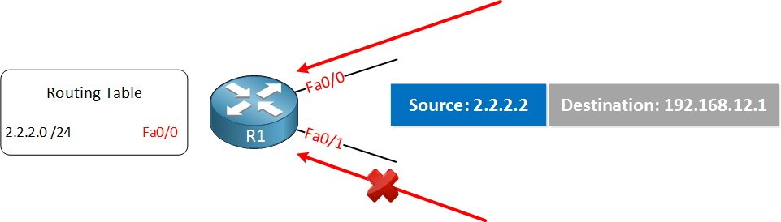
Reverse Path Filtering in Linux Kernel
Related term: Reverse-Path Forwarding (RPF)
Threat: Spoofing from outside network
(using internal src_ip → pretending to be inside)
→ Cause damage
Router doesn’t want to do that! How?
IP address spoofing!
Prevent IP address spoofing
Reverse path filtering (rp_filter)
Check the source of the recived packet is reachable through the interface it came in
Packge is routable through the interface which it came: accept the packet
Packge is not routable through the interfxace: drop that packet.

Slide 44
Reverse Path Filtering in Linux Kernel
Related term: Reverse-Path Forwarding (RPF)
Threat: Spoofing from outside network
(using internal src_ip → pretending to be inside)
→ Cause damage
Router doesn’t want to do that! How?
Symmetric routing
When R get a packet from interface A,
→ do a reverse lookup, if the return path goes to the same interface? → OK = Allow
Otherwise, Asymmetric routing → Drop
IP address spoofing!
packets are arriving from a legitimate path!
!!! Very obscure and important rule inside the Linux Kernel, providing a level of protecting against packet spoofing

Slide 45
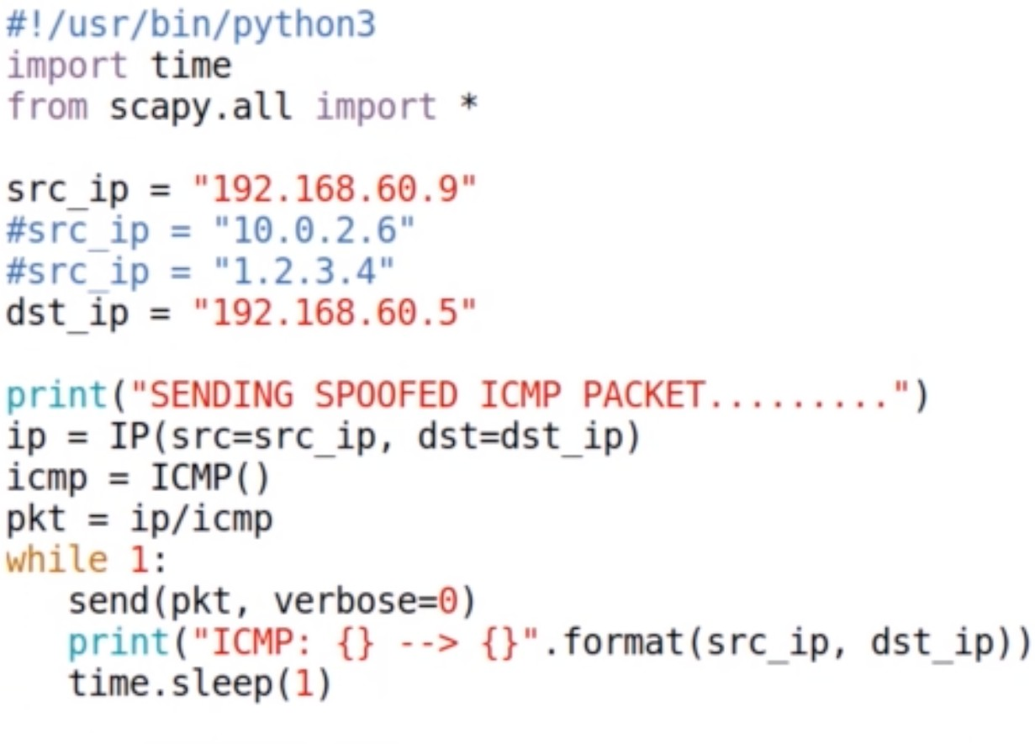
IP Spoofing
Demo - attack code

Slide 46
ICMP Protocol
and Attacks
NT101 – Network Security

Slide 47
ICMP: internet control message protocol
ICMP protocol
used by hosts and routers to communicate network-level information
Error reporting: unreachable host, network, port, protocol, time exceeded
Control messages:
echo request/reply (used by ping)
Redirect
Timestamp request/reply
Router advertisement/solicitation
ICMP messages carried in IP datagrams
ICMP message: type, code plus first 8 bytes of IP datagram causing error

Slide 48
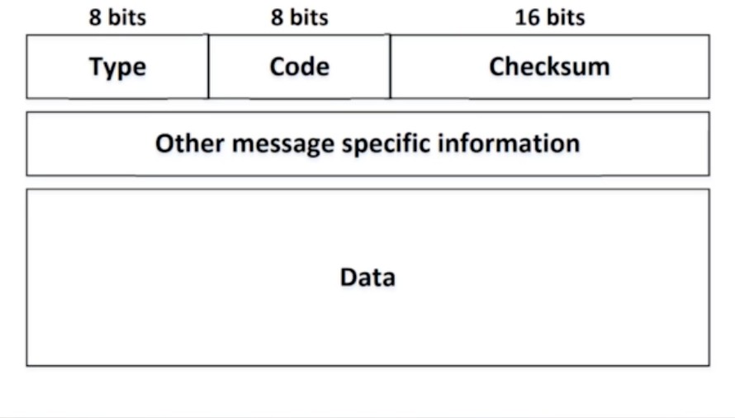
ICMP Header
ICMP header format
 | Type 0 | Code 0 | description echo reply (ping)
 | 3 | 0 | dest. network unreachable
 | 3 | 1 | dest host unreachable
 | 3 | 2 | dest protocol unreachable
 | 3 | 3 | dest port unreachable
 | 3 | 6 | dest network unknown
 | 3 | 7 | dest host unknown
 | 4 | 0 | source quench (congestion
 |  |  | control - not used)
 | 8 | 0 | echo request (ping)
 | 9 | 0 | route advertisement
 | 10 | 0 | router discovery
 | 11 | 0 | TTL expired
 | 12 | 0 | bad IP header

Slide 49
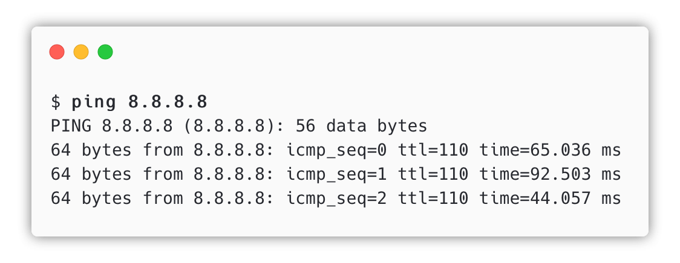
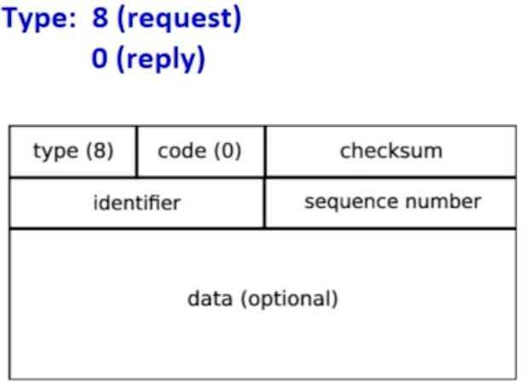
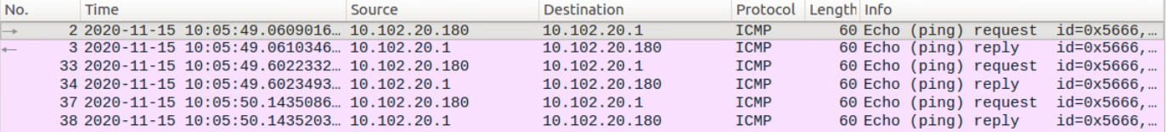
ICMP Echo Request/Reply
ICMP basis

Slide 50
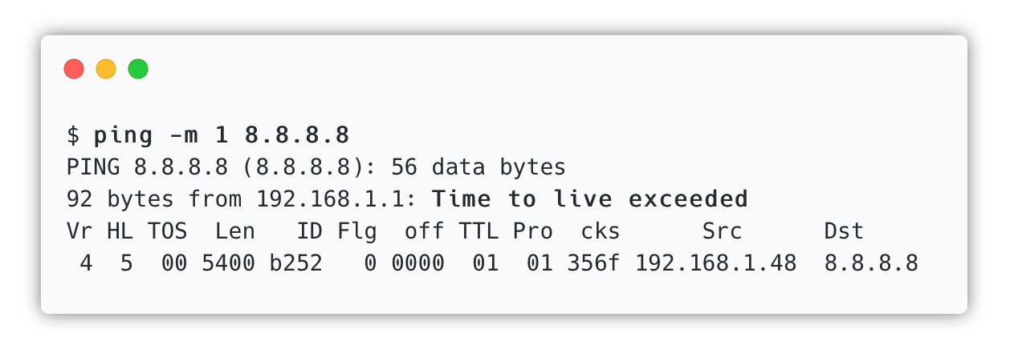
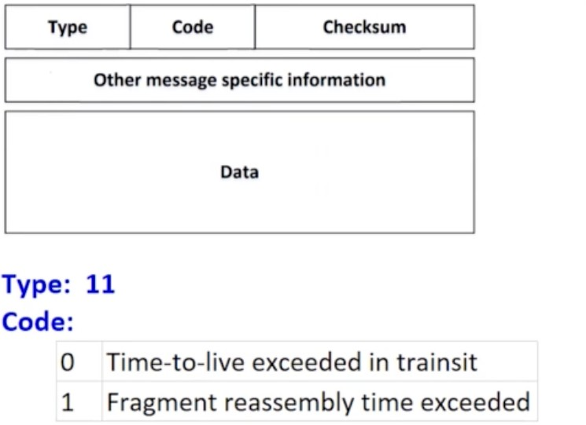
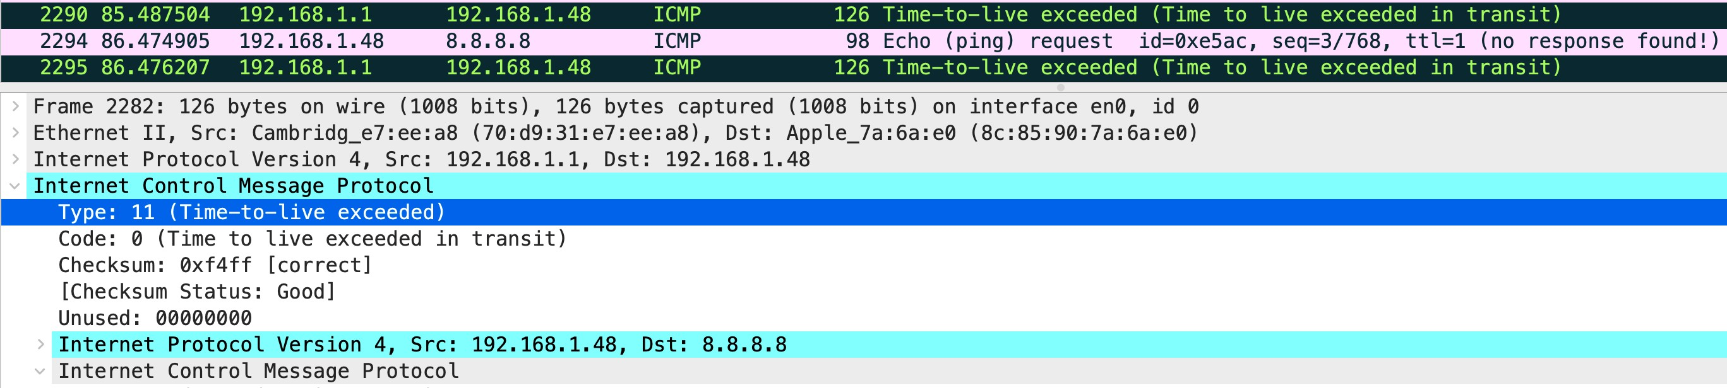
ICMP TTL Exceeded
Time-to-live exceeded
TTL Max = 255,
Reduced by one before the node is routed onward

Slide 51
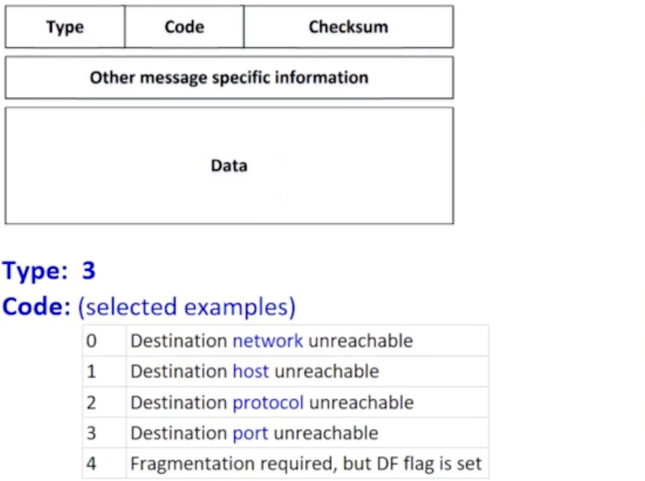
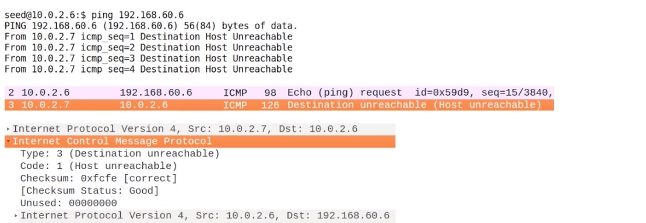
ICMP Destination Unreachable
Error detection

Slide 52
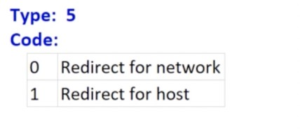
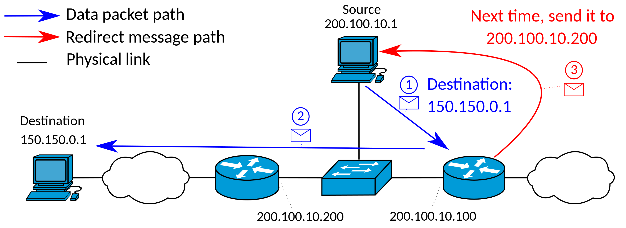

ICMP Redirect Messages and Attacks
ICMP Redirect
ICMP redirect message = to inform a host of a more optimal route through a network
possibly used maliciously for attacks that redirect traffic to a specific node
LAN
Attacker
➔ MITM Attack

Slide 53
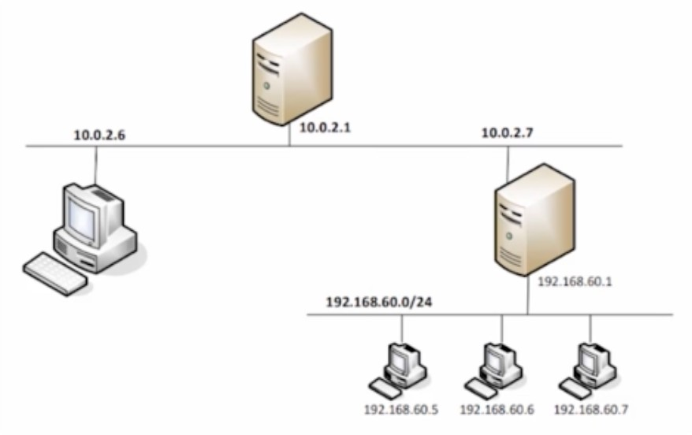
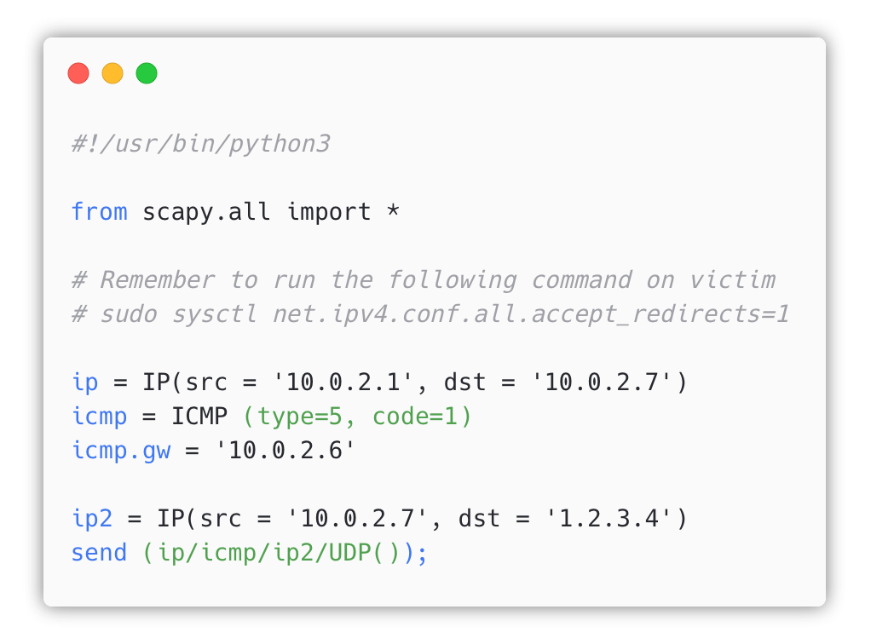
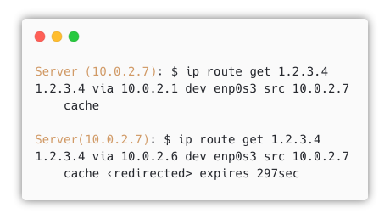
ICMP Redirect and Attacks
Attack code
Execution Result

Slide 54
Question: ICMP Redirect attacks
ICMP Attacks
Question 1: Can you launch ICMP redirect from a remote computer?
Question 2: Can you use ICMP redirect attacks to redirect to a remote computer?

Slide 55
Question: ICMP Redirect attacks
ICMP Attacks
Question 1: Can you launch ICMP redirect from a remote computer?
Question 2: Can you use ICMP redirect attacks to redirect to a remote computer?
No! When A receiving ICMP Redirect, it will check the gateway is on the same network or not If not → ignore

Slide 56
Question: ICMP Redirect attacks
ICMP Attacks
Question 1: Can you launch ICMP redirect from a remote computer?
No! Reverse path filtering (RPF) at the router will drop them!
Question 2: Can you use ICMP redirect attacks to redirect to a remote computer?
No! When A receiving ICMP Redirect, it will check the gateway is on the same network or not If not → ignore

Slide 57

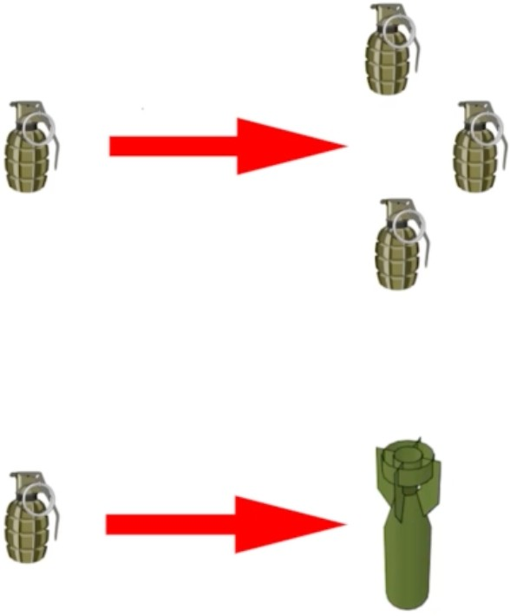
DoS Attacks strategies
Analogy: A real war!
UDP DoS Attack (will be discussed later on!)

Slide 58
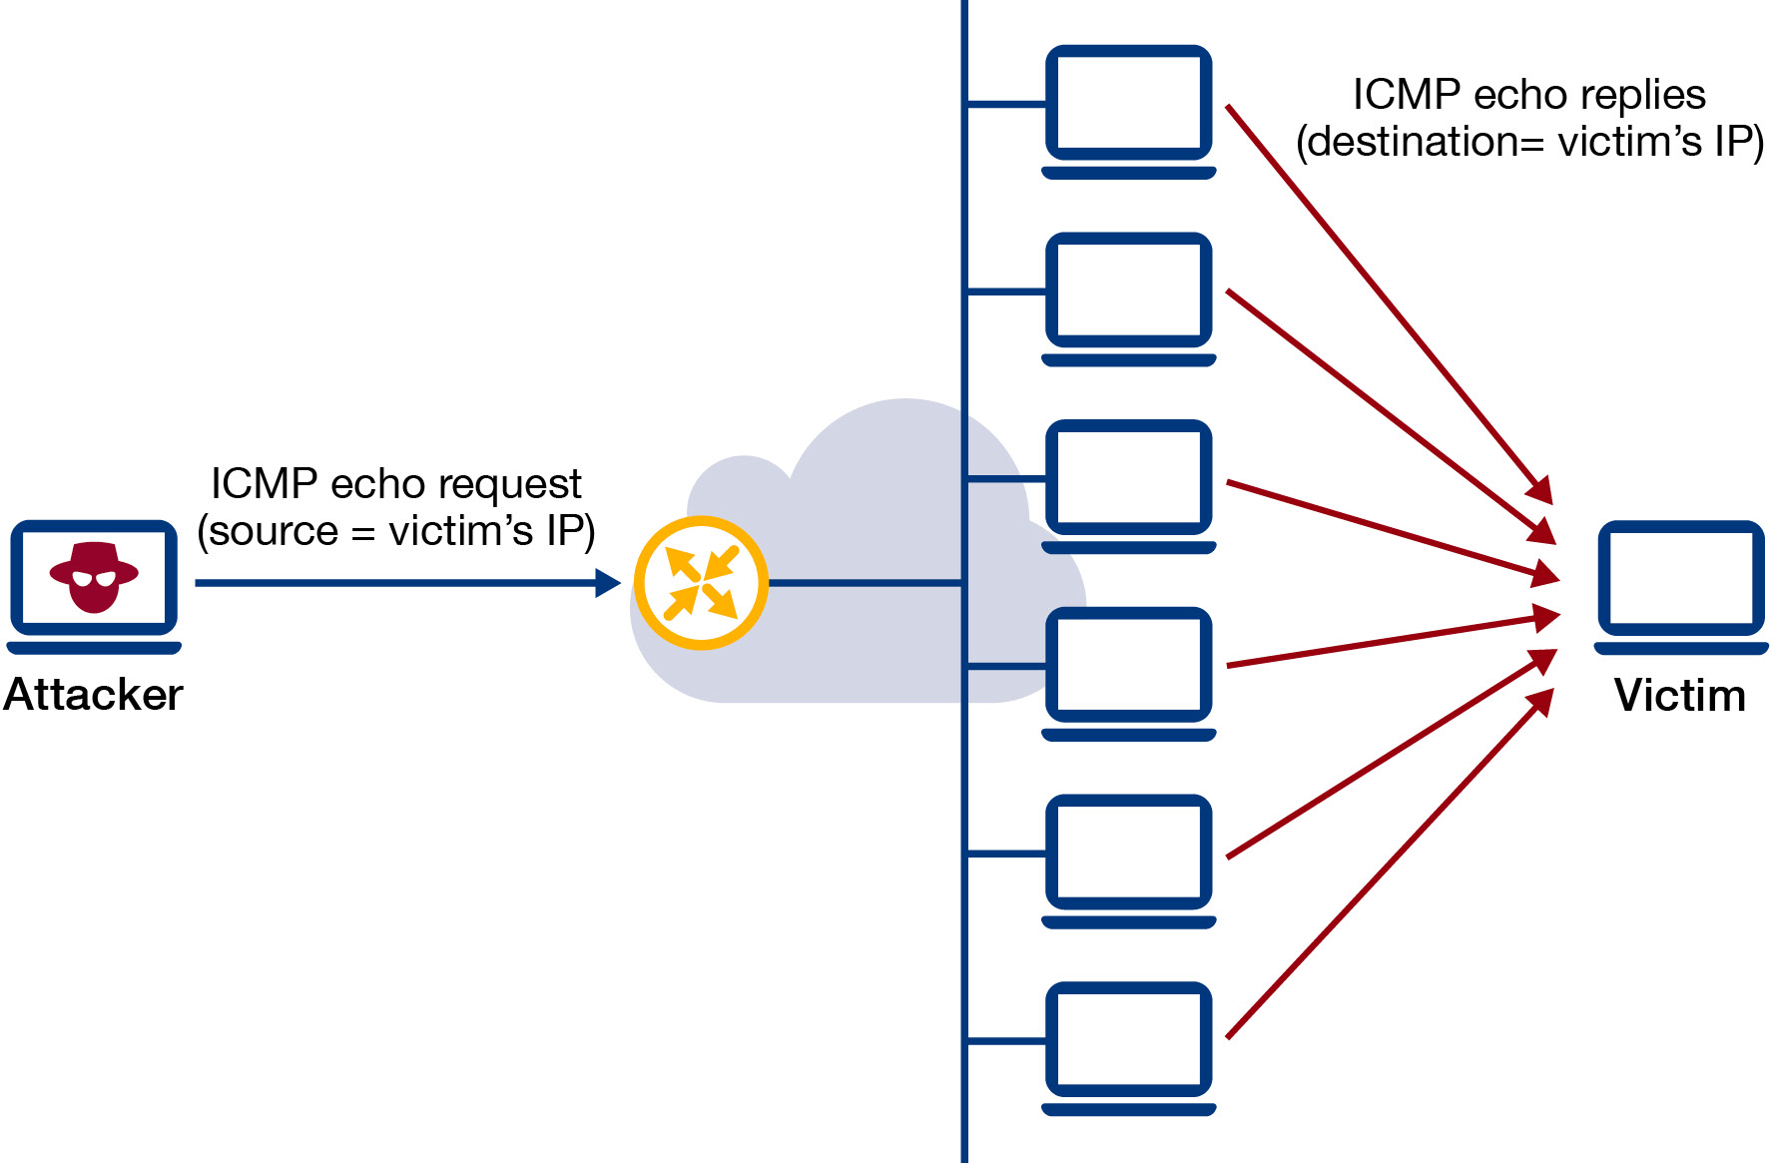
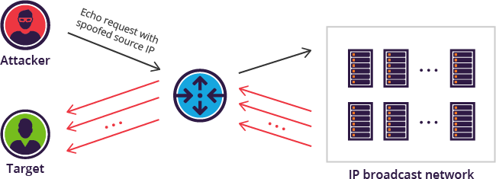
Smurf Attack
Attack ideas
Spoofing source IP
https://www.imperva.com/learn/ddos/smurf-attack-ddos/

Slide 59
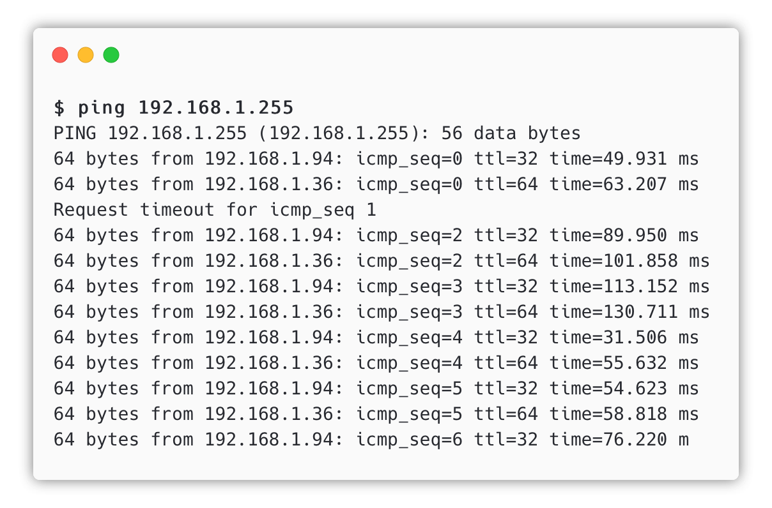
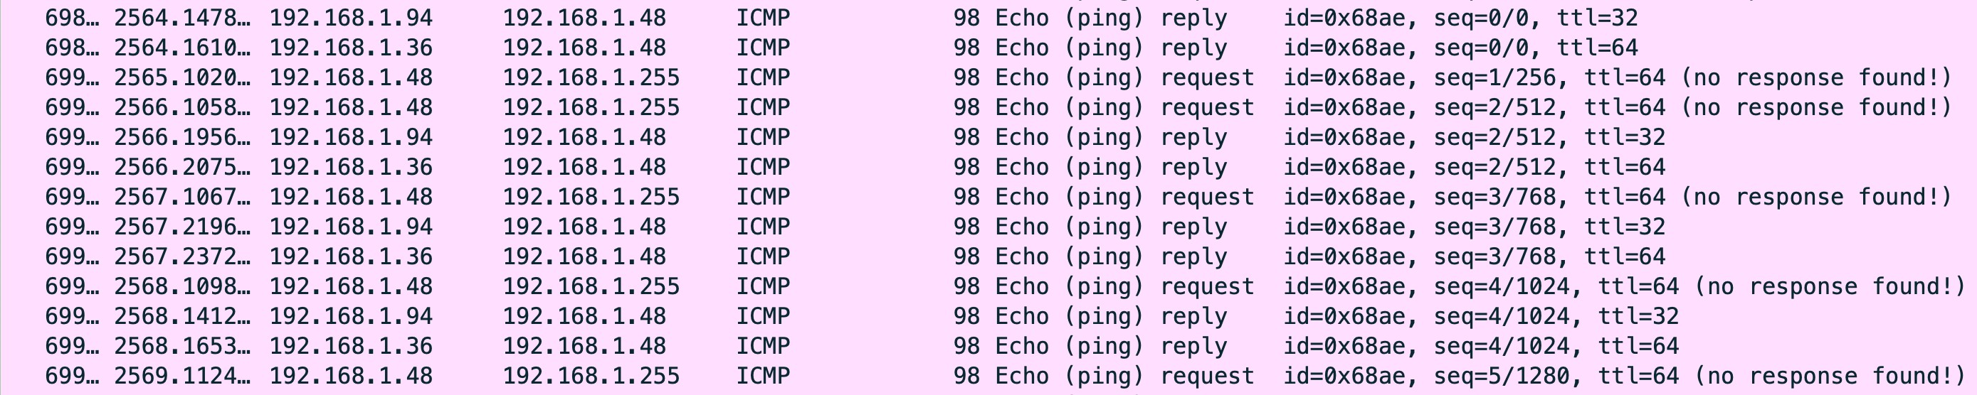
Smurf Attack
Simple demo
What happened if we ping to the broadcast address?
How to prevent Smurf Attack?

Slide 60

Various attacks using ICMP
Other ICMP attacks
ICMP Flooding
Reconnaissance attack: gather all possible information about the target before launching an actual attack
https://www.cloudflare.com/learning/ddos/ping-icmp-flood-ddos-attack/

Slide 61
Summary
What have we learned?
The Role of the IP layer
IP Header
IP Fragmentation and Attacks
Routing
ICMP and Attacks

Slide 62

Homework
Lab exercise
IP and ICMP Attacks Lab (Link)
The objective of this lab is for students to gain the first-hand experience on various attacks at the IP layer.
Working in a team (your final-project team) or individually.

Slide 63


For next time…
Looking ahead
Ready for next class:
Tentative topic: Transport Layer and Attacks
Reading and practicing (in advance):
SEED book, Chapter 16
Refs: https://www.handsonsecurity.net/resources.html
SEED Lab: TCP Attacks Lab and Mitnick Attack Lab
Refs:
https://seedsecuritylabs.org/Labs_16.04/Networking/TCP_Attacks/
https://seedsecuritylabs.org/Labs_16.04/Networking/Mitnick_Attack/

Slide 64

Today end,
Congrats!

